Slide 1

Organizational Behavior
Eighteenth Edition, Global Edition
Chapter 7
Motivation Concepts
Copyright © 2019 Pearson Education, Ltd. All Rights Reserved.
Notes:
If this PowerPoint presentation contains mathematical equations, you may need to check that your computer has the following installed:
1) MathType Plugin
2) Math Player (free versions available)
3) NVDA Reader (free versions available)
Welcome to this Organizational Behavior course that uses the 18th edition of the textbook, Organizational Behavior by Robbins and Judge. This is considered among the most widely used OB textbooks in the world. Robbins and Judge are recognized as definitive aggregators of OB concepts, applications, and practices. The course and this book will provide you with a resource that will benefit you throughout your degree program and your professional life.

Slide 2
Learning Objectives (1 of 2)
7.1 Describe the three key elements of motivation.
7.2 Compare the early theories of motivation.
7.3 Contrast the elements of self-determination theory and goal-setting theory.
7.4 Understand the differences among self-efficacy theory, reinforcement theory, and expectancy theory.
Notes:
After studying this chapter, you should be able to:
Describe the three key elements of motivation.
Compare the early theories of motivation.
Contrast the elements of self-determination theory and goal-setting theory.
Understand the differences among self-efficacy theory, reinforcement theory, and expectancy theory.

Slide 3
Learning Objectives (2 of 2)
7.5 Describe the forms of organizational justice, including distributive justice, procedural justice, informational justice, and interactional justice.
7.6 Identify the implications of employee job engagement for managers.
7.7 Describe how the contemporary theories of motivation complement one another.
Notes:
In addition, after studying this chapter, you should be able to:
Describe the forms of organizational justice, including distributive justice, procedural justice, informational justice, and interactional justice.
Identify the implications of employee job engagement for managers.
Describe how the contemporary theories of motivation complement one another.

Slide 4
Describe the Three Key Elements of Motivation (1 of 2)
Motivation is the processes that account for an individual’s intensity, direction, and persistence of effort toward attaining a goal.
The level of motivation varies both between individuals and within individuals at different times.
Types of Motivation:
  Intrinsic (internal) eg ambition
  Extrinsic (external) eg reward
Notes:
Motivation is the processes that account for an individual’s intensity, direction, and persistence of effort toward attaining a goal. We will narrow the focus to organizational goals in order to reflect our singular interest in work-related behavior. Keep in mind that the level of motivation varies both between individuals and within individuals at different times.

Slide 5
Describe the Three Key Elements of Motivation (2 of 2)
The three key elements of motivation are:
  Intensity: concerned with how hard a person tries.
  Direction: the orientation that benefits the organization.
  Persistence: a measure of how long a person can maintain his/her effort.
Notes:
The three key elements of our definition of motivation are intensity, direction, and persistence. Intensity is concerned with how hard a person tries to do anything. This is the element most of us focus on when we talk about motivation. Direction is the orientation that benefits the organization; it can be positive or negative. Persistence is a measure of how long a person can maintain his or her effort. Motivated individuals stay with a task long enough to achieve their goal.

Slide 6
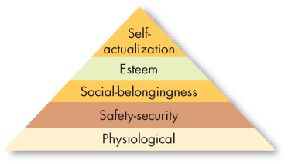
Compare the Early Theories of Motivation (1 of 7)
Exhibit 7-1 Maslow’s Hierarchy of Needs
Notes:
Abraham Maslow’s hierarchy of needs is the most well-known theory of motivation. Maslow hypothesized that within every human being there exists a hierarchy of five needs, beginning with physiological needs that include hunger, thirst, shelter, sex, and other bodily needs. The second level is safety needs that include security and protection from physical and emotional harm. The next level is social needs that include affection, belongingness, acceptance, and friendship. Reaching a higher level, we find esteem needs that include internal esteem factors such as self-respect, autonomy, and achievement, and external esteem factors such as status, recognition, and attention. At the top of the hierarchy is self-actualization needs; this is the drive to become what one is capable of becoming, and includes growth, achieving one’s potential, and self-fulfillment.
Maslow separated the five needs into higher and lower orders. As a need becomes substantially satisfied, the next need becomes dominant. No need is ever fully gratified; a substantially satisfied need no longer motivates.
Recently, a sixth need has been proposed for a highest level – intrinsic values—which is said to have originated from Maslow, but it has yet to gain widespread acceptance.

Slide 7
Compare the Early Theories of Motivation (2 of 7)
Maslow’s need theory has received wide recognition, particularly among practicing managers.
  It is intuitively logical and easy to understand and some research has validated it.
  However, most research does not, and it hasn’t been frequently researched since the 1960s.
Notes:
Maslow’s need theory has received wide recognition, particularly among practicing managers. It is intuitively logical and easy to understand and some research has validated it. However, most research does not, and it hasn’t been frequently researched since the 1960s.

Slide 8
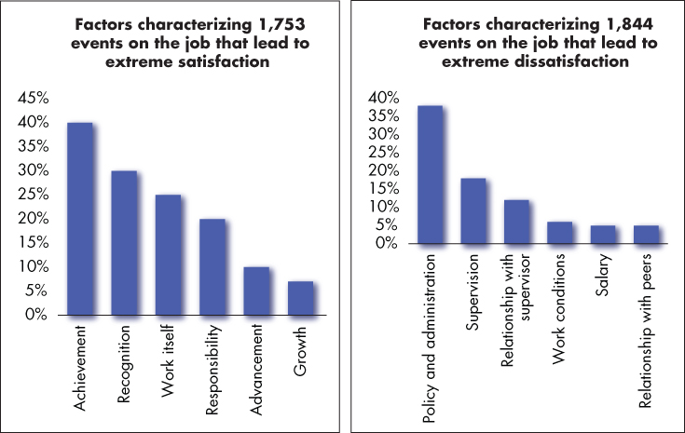
Compare the Early Theories of Motivation (3 of 7)
Exhibit 7-2 Comparison of Satisfiers and Dissatisfiers
Source: Based on Harvard Business Review, “Comparison of Satisfiers and Dissatisfiers,” An exhibit from One More Time: How Do You Motivate Employees? by Frederick Herzberg, January 2003. Copyright © 2003 by the Harvard Business School Publishing Corporation. All rights reserved.
Notes:
Proposed by psychologist Frederick Herzberg when he investigated the question, “What do people want from their jobs?” the two-factor theory is sometimes also called motivation-hygiene theory. Herzberg asked people to describe situations in which they felt exceptionally good or bad about their jobs. These responses were then tabulated and categorized.
From the categorized responses, as shown here in Exhibit 7-2, Herzberg concluded that intrinsic factors, such as advancement, recognition, responsibility, and achievement seem to be related to job satisfaction. Dissatisfied respondents tended to cite extrinsic factors, such as supervision, pay, company policies, and working conditions.
Moreover, the opposite of satisfaction is not dissatisfaction. Removing dissatisfying characteristics from a job does not necessarily make the job satisfying. Job satisfaction factors are separate and distinct from job dissatisfaction factors.

Slide 9
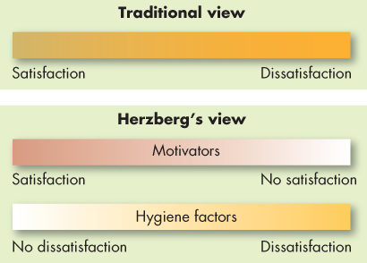
Compare the Early Theories of Motivation (4 of 7)
Exhibit 7-3 Contrasting View of Satisfaction and Dissatisfaction
Notes:
Managers who eliminate job dissatisfaction factors may not necessarily bring about motivation. Exhibit 7-3 reveals that when hygiene factors are adequate, people will not be dissatisfied. Neither will they be satisfied. To motivate people, managers must emphasize intrinsically rewarding factors that are associated with the work itself or to outcomes directly derived from it.

Slide 10
Compare the Early Theories of Motivation (5 of 7)
Criticisms of Herzberg’s theory:
  Limited because it relies on self-reports.
  Reliability of methodology is questioned.
  No overall measure of satisfaction was utilized.
Notes:
Recent reviews of Herzberg’s research have resulted in many criticisms of the theory. The procedure that Herzberg used is limited by its methodology, therefore, the reliability of Herzberg’s methodology is questioned. For example, no overall measure of satisfaction was utilized.
Regardless of criticisms, Herzberg’s theory has been widely read, and few managers are unfamiliar with his recommendations.

Slide 11
Compare the Early Theories of Motivation (6 of 7)
McClelland’s Theory of Needs
  The theory focuses on three needs:
    Need for achievement (nAch): drive to excel, to achieve in relation to a set of standards, to strive to succeed.
    Need for power (nPow): need to make others behave in a way that they would not have behaved otherwise.
    Need for affiliation (nAfl): desire for friendly and close interpersonal relationships.
Notes:
Another traditional theory is McClelland’s Theory of Needs. This theory focuses on three needs: achievement, power, and affiliation. Let’s look at each one in more detail.
The first of this theory’s variables is achievement need, abbreviated as nAch, which is the drive to excel, to achieve in relation to a set of standards, and to strive to succeed. High achievers perform best when they perceive their probability of success as 50/50. They like to set goals that require stretching themselves a little.
Need for power, the second variable, is the need to make others behave in a way that they would not have behaved otherwise. The need for power, abbreviated as nPow, is the desire to have impact, to be influential, and to control others. Individuals high in nPow enjoy being “in charge.” They strive for influence over others. They prefer to be placed into competitive and status-oriented situations. They also tend to be more concerned with prestige and gaining influence over others than with effective performance.
Finally, the need for affiliation, abbreviated as nAfl, is the desire for friendly and close personal relationships. This need has received the least attention from researchers. In general, individuals with high affiliation strive for friendship and prefer cooperative situations over competitive ones. They typically desire relationships involving a high degree of mutual understanding.

Slide 12
Compare the Early Theories of Motivation (7 of 7)
McClelland’s theory has had the best support.
  It has less practical effect than the others.
  Because McClelland argued that the three needs are subconscious—we may rank high on them but not know it—measuring them is not easy.
  It is more common to find situations in which managers aware of these motivational drivers label employees based on observations made over time.
Notes:
Among the early theories of motivation, McClelland’s has had the best research support, particularly cross-culturally. Unfortunately, it has less practical effect than the others. McClelland argued that the three needs are subconscious – we may rank high on them, but not know it. Because of this, measuring them is not easy.
It is more common to find situations in which managers aware of these motivational drivers label employees based on observations made over time.

Slide 13
Self-Determination Theory vs. Goal-Setting Theory (1 of 9)
Self-Determination Theory
  People prefer to feel they have control over their actions.
    Focus on the beneficial effects of intrinsic motivation and harmful effects of extrinsic motivation.
    Cognitive evaluation theory - When people are paid for work, it feels less like something they want to do and more like something they have to do.
  Proposes that in addition to being driven by a need for autonomy, people seek ways to achieve competence and positive connections to others.
Notes:
Early theories of motivation have not been supported by research or have fallen out favor. In contrast, contemporary theories have generally been supported, but caution is still in order.
We begin our discussion of contemporary motivation theories with self-determination theory, which proposes that people prefer to feel they have control over their actions, so anything that makes a previously enjoyed task feel more like an obligation than a freely chosen activity will undermine motivation. Much research on self-determination theory in OB has focused on cognitive evaluation theory, which hypothesizes that extrinsic rewards will reduce intrinsic interest in a task. For example, when people are paid for work, it feels less like something they want to do and more like something they have to do. Self-determination theory also proposes that in addition to being driven by a need for autonomy, people seek ways to achieve competence and positive connections to others. However, of all the three needs, the autonomy need is the most important for attitudinal and affective outcomes, whereas the competence need appears to be most important for predicting performance.

Slide 14
Self-Determination Theory vs. Goal-Setting Theory (2 of 9)
When extrinsic rewards are used as payoffs for performance, employees feel they are doing a good job.
  Eliminating extrinsic rewards can also shift an individual’s perception of why he or she works on a task from an external to an internal explanation.
Self-determination theory acknowledges that extrinsic rewards can improve even intrinsic motivation under specific circumstances.
Notes:
When organizations use extrinsic rewards as payoffs for superior performance, employees feel they are doing a good job less because of their own intrinsic desire to excel than because that’s what the organization wants. Eliminating extrinsic rewards can also shift an individual’s perception of why he or she works on a task from an external to an internal explanation. For example, if you’re reading a novel a week because your English literature instructor requires you to, you can attribute your reading behavior to an external source. However, if you find yourself continuing to read a novel each week after the course is over, your natural inclination is to say, “I must enjoy reading novels because I’m still reading one each week.”
Studies examining how extrinsic rewards increased motivation for some creative tasks suggest we might need to place cognitive evaluation theory’s predictions in a broader context. Goal setting is more effective in improving motivation, for instance, when we provide rewards for achieving the goals. The original authors of self-determination theory acknowledge that extrinsic rewards, such as verbal praise and feedback about competence, can improve even intrinsic motivation under specific circumstances. Deadlines and specific work standards do, too, if people believe they are in control of their behavior. This is consistent with the central theme of self-determination theory: rewards and deadlines diminish motivation if people see them as coercive.

Slide 15
Self-Determination Theory vs. Goal-Setting Theory (3 of 9)
What does self-determination theory suggest for providing rewards?
Self-concordance: considers how strongly people’s reasons for pursuing goals are consistent with their interests and core values.
Notes:
Self-determination theory creates suggestions for providing rewards. For example, if a senior sales representative really enjoys selling and making the deal, a commission indicates he’s been doing a good job and increases his sense of competence by providing feedback that could improve intrinsic motivation. If a computer programmer values writing code because she likes to solve problems, a reward for working toward an externally imposed standard she does not accept, such as writing a certain number of lines of code every day, could feel coercive, and her intrinsic motivation could suffer. She could be less interested in the task and might reduce her effort.
A recent outgrowth of self-determination theory is self-concordance, which considers how strongly peoples’ reasons for pursuing goals are consistent with their interests and core values. If individuals pursue goals because of an intrinsic interest, they are more likely to attain their goals and are happy even if they do not. The process of striving toward them is fun. In contrast, people who pursue goals for extrinsic reasons, like money or status, are less likely to attain their goals and are less happy even when they do because the goals are less meaningful to them. OB research suggests that people who pursue work goals for intrinsic reasons are more satisfied with their jobs, feel they fit into their organizations better, and may perform better.

Slide 16
Self-Determination Theory vs. Goal-Setting Theory (4 of 9)
What does all of this mean?
  For individuals:
    Choose your job for reasons other than extrinsic rewards.
  For organizations:
    Provide intrinsic as well as extrinsic incentives.
Notes:
What does all of this mean? For individuals, it means to choose your job for reasons other than extrinsic rewards. For organizations, it means managers should provide intrinsic as well as extrinsic incentives. They need to make the work interesting, provide recognition, link organizational and employee goals, and support employee growth and development. Employees who feel what they do is within their control and a result of free choice are likely to be more motivated by their work and committed to their employers.

Slide 17
Self-Determination Theory vs. Goal-Setting Theory (5 of 9)
Goal-Setting Theory
  Goals tell an employee what needs to be done and how much effort is needed.
Evidence suggests:
  Specific goals increase performance.
  Difficult goals, when accepted, result in higher performance than do easy goals.
  Feedback leads to higher performance than does non-feedback.
Notes:
Edwin Locke’s goal-setting theory proposed that intentions to work toward a goal are a major source of work motivation. Goals tell an employee what needs to be done and how much effort is needed. Evidence strongly suggests that specific goals increase performance, and that difficult goals, when accepted, result in higher performance than do easy goals. Also, people will do better when they get feedback on how well they are progressing toward their goals. Self-generated feedback is more powerful a motivator than externally generated feedback.

Slide 18
Self-Determination Theory vs. Goal-Setting Theory (6 of 9)
Three other factors influencing the goals-performance relationship:
  Goal commitment
  Task characteristics
  National culture
Notes:
There are contingencies in goal-setting theory. In addition to goal acceptance, difficulty level, and feedback, three other factors influence the goals-performance relationship: goal commitment, task characteristics, and national culture.
Goal-setting theory presupposes that an individual is committed to the goal, believes it can be achieved, and wants to achieve it. Goal commitment is most likely to occur when the employee expects that their efforts will pay off in goal attainment, when accomplishing the goal is attractive to them, and when they actively participate in goal setting.
Goals themselves seem to affect performance more strongly when task characteristics are: simple rather than complex and independent rather than interdependent. On interdependent tasks, group goals along with delegation of tasks are preferable.
Setting specific, difficult individual goals may have different effects in different cultures. Research has not shown that group-based goals are more effective in collectivists than in individualist cultures. In collectivist and high-power-distance cultures, achievable moderate goals can be more highly motivating than difficult ones. Finally, assigned goals appear to generate greater goal commitment in high than in low-power-distance cultures. More research is needed to assess how goal constructs might differ across cultures.

Slide 19
Self-Determination Theory vs. Goal-Setting Theory (7 of 9)
People differ in the way they regulate their thoughts and behaviors.
  Those with a promotion focus strive for advancement and accomplishment and approach conditions that move them closer toward desired goals.
  Those with a prevention focus strive to fulfill duties and obligations and avoid conditions that pull them away from desired goals.
Notes:
Research has also found that people differ in the way they regulate their thoughts and behaviors during goal pursuit. Generally, people fall into one of two categories, though they could belong to both. Those with a promotion focus strive for advancement and accomplishment and approach conditions that move them closer toward desired goals. Those with a prevention focus strive to fulfill duties and obligations and avoid conditions that pull them away from desired goals. Which is the better strategy? Ideally, it’s probably best to be both promotion and prevention oriented.

Slide 20
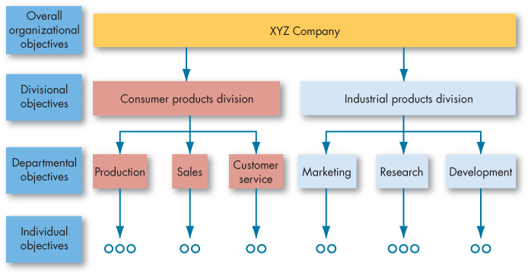
Self-Determination Theory vs. Goal-Setting Theory (8 of 9)
Exhibit 7-4 Cascading of Objectives
Notes:
How do you put goal-setting operations into practice? Management by Objectives (MBO) allows employees to participatively set goals that are tangible, verifiable, and measurable. As shown in Exhibit 7-4, an organization’s overall objectives are translated into specific objectives for each succeeding level. Four ingredients common to MBO programs are: goal specificity, participation in decision making, explicit time period, and performance feedback. MBO programs are common in many business, healthcare, educational, government, and nonprofit organizations.

Slide 21
Self-Determination Theory vs. Goal-Setting Theory (9 of 9)
Goal Setting and Ethics
  The relationship between goal setting and ethics is quite complex: if we emphasize the attainment of goals, what is the cost?
  We may forgo mastering tasks and adopt avoidance techniques so we don’t look bad, both of which can incline us toward unethical choices.
  Break
Notes:
The relationship between goal setting and ethics is quite complex: if we emphasize the attainment of goals, what is the cost? The answer is probably found in the standards we set for goal achievement. If we are put under time pressure and worry about that, thoughts about time turn against us.
Time pressure often increases as we are nearing a goal, which can tempt us to act unethically to achieve it. We may forgo mastering tasks and adopt avoidance techniques so we don’t look bad, both of which can incline us toward unethical choices.

Slide 22
Self-Efficacy, Reinforcement, and Expectancy Theory (1 of 8)
Self-efficacy theory is an individual’s belief that he or she is capable of performing a task.
  Enactive mastery
  Vicarious modeling
  Verbal persuasion
  Arousal
Also known as social cognitive theory and social learning theory.
Notes:
Self-efficacy theory, also known as social cognitive theory and social learning theory, is a new theory gaining much attention. The theory defines four characteristics: enactive mastery, or gaining relevant experience with the task or job; vicarious modeling, or becoming more confident because you see someone else doing the task; verbal persuasion, occurring when a person is more confident because someone convinces him that he has the skills; and arousal, which leads to an energized state, driving a person to complete the task.

Slide 23
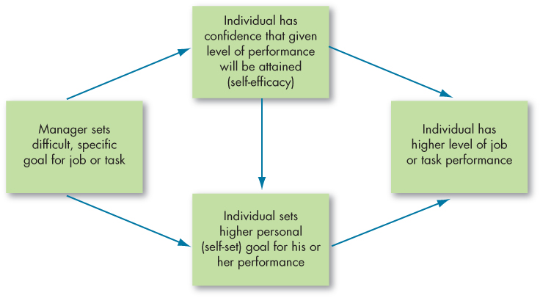
Self-Efficacy, Reinforcement, and Expectancy Theory (2 of 8)
Exhibit 7-5 Joint Effects of Goals and Self-Efficacy on Performance
Source: Based on E. A. Locke and G. P. Latham, “Building a Practically Useful Theory of Goal Setting and Task Motivation: A 35-Year Odyssey,” American Psychologist (September 2002): 705–17.
Notes:
What role does equity play in motivation? Equity theory argues that individuals make comparisons of their job inputs and outcomes relative to those of others and then respond to any inequities. If we perceive our ratio to be equal to that of the relevant others with whom we compare ourselves, a state of equity is said to exist. We perceive our situation as fair. When we see the ratio as unequal, we experience equity tension.
The researcher who developed self-efficacy theory, Albert Bandura, proposes four ways self-efficacy can be increased:
1. Enactive mastery.
2. Vicarious modeling.
3. Verbal persuasion.
4. Arousal.

Slide 24
Self-Efficacy, Reinforcement, and Expectancy Theory (3 of 8)
Implications of self-efficacy theory:
  The best way for a manager to use verbal persuasion is through the Pygmalion effect.
    A form of self-fulfilling prophecy – believing in something can make it true.
  Training programs often make use of enactive mastery by having people practice and build their skills.
Notes:
What are the implications of self-efficacy theory? First, training programs often make use of enactive mastery by having people practice and build their skills. In fact, one reason training works is that it increases self-efficacy. Second, individuals with higher levels of self-efficacy also appear to reap more benefits from training programs and are more likely to use their training on the job.
The best way for a manager to use verbal persuasion is through the Pygmalion effect. A form of self-fulfilling prophecy – believing in something can make it true.

Slide 25
Self-Efficacy, Reinforcement, and Expectancy Theory (4 of 8)
Reinforcement theory: behavior is a function of its consequences.
  Reinforcement conditions behavior.
  Behavior is environmentally caused.
Goal setting is a cognitive approach: an individual’s purposes direct his or her action.
Operant conditioning theory: people learn to behave to get something they want or to avoid something they don’t want.
  B.F. Skinner’s behaviorism.
Notes:
Let’s look at reinforcement theory. While goal setting is a cognitive approach proposing that an individual’s purposes direct his or her action, reinforcement theory, by contrast, takes a behavioristic view, arguing that reinforcement conditions behavior. The two theories are clearly at odds, philosophically. Reinforcement theorists see behavior as environmentally caused, ignoring the inner state of the individual and concentrating solely on what happens when he or she takes some action. Because it does not concern itself with what initiates behavior, it is not, strictly speaking, a theory of motivation. But it does provide a powerful means of analyzing what controls behavior, and this is why we typically consider it in discussions of motivation.
Operant conditioning theory argues that people learn to behave to get something they want or to avoid something they don’t want. Unlike reflexive or unlearned behavior, operant behavior is influenced by the reinforcement or lack of reinforcement brought about by its consequences. Reinforcement strengthens a behavior and increases the likelihood it will be repeated. B. F. Skinner, one of the most prominent advocates of operant conditioning, argued that creating pleasing consequences to follow specific forms of behavior would increase the frequency of that behavior – a theory known as behaviorism. He demonstrated that people will most likely engage in desired behaviors if they are positively reinforced for doing so, that rewards are most effective if they immediately follow the desired response, and that behavior that is not rewarded or is punished is less likely to be repeated.

Slide 26
Self-Efficacy, Reinforcement, and Expectancy Theory (5 of 8)
Social-learning theory: we can learn through both observation and direct experience.
  Models are central, and four processes determine their influence on an individual:
    Attentional processes
    Retention processes
    Motor reproduction processes
    Reinforcement processes
Notes:
Social-learning theory argues that we can learn through both observation and direct experience. Models are central to the social-learning viewpoint. Four processes determine their influence on an individual:
Attentional processes: people learn from a model only when they recognize and pay attention to its critical features.
Retention processes: a model’s influence depends on how well the individual remembers the model’s action after the model is no longer readily available.
Motor reproduction processes: after a person has seen a new behavior by observing the model, watching must be converted to doing.
Reinforcement processes: individuals are motivated to exhibit the modeled behavior if positive incentives or rewards are provided.

Slide 27
Self-Efficacy, Reinforcement, and Expectancy Theory (6 of 8)
Expectancy theory: a tendency to act in a certain way depends on an expectation that the act will be followed by a given outcome and on the attractiveness of that outcome to the individual.
Three relationships:
  Effort-performance relationship
  Performance-reward relationship
  Rewards-personal goals relationship
Notes:
Expectancy theory is one of the most widely accepted explanations of motivation. Victor Vroom’s expectancy theory has its critics, but most of the research is supported. Expectancy theory argues that the strength of one’s tendency to act in a certain way depends on the strength of the expectation that the act will be followed by a given outcome and on the attractiveness of that outcome to the individual. It says that an employee will be motivated to exert a high level of effort when he or she believes that effort will lead to a good performance appraisal, that a good appraisal will lead to organizational rewards, and that the rewards will satisfy his or her personal goals.

Slide 28
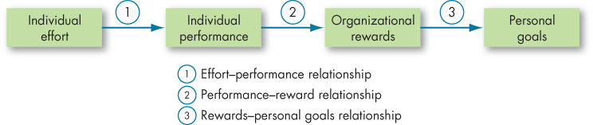
Self-Efficacy, Reinforcement, and Expectancy Theory (7 of 8)
Exhibit 7-6 Expectancy Theory
Notes:
Exhibit 7-6 shows the three key relationships:
Expectancy: the effort–performance relationship, which is the probability perceived by the individual that exerting a given amount of effort will lead to performance;
Instrumentality: the performance–reward relationship, which is the degree to which the individual believes that performing at a particular level will lead to the attainment of a desired outcome;
Valence: the rewards–personal goals relationship, which is the degree to which organizational rewards satisfy an individual’s personal goals or needs and the attractiveness of those potential rewards for the individual.

Slide 29
Self-Efficacy, Reinforcement, and Expectancy Theory (8 of 8)
Expectancy theory helps explain why a lot of workers aren’t motivated and do only the minimum.
Three questions employees need to answer in the affirmative if their motivation is to be maximized:
  If I give maximum effort, will it be recognized in my performance appraisal?
  If I get a good performance appraisal, will it lead to organizational rewards?
  If I’m rewarded, are the rewards attractive to me?
Notes:
Expectancy theory helps explain why a lot of workers aren’t motivated on their jobs and do only the minimum necessary to get by. We can look at the theory’s three relationships by asking three questions that employees would need to answer affirmatively if they are to be motivated: First, if I give maximum effort, will it be recognized in my performance appraisal? Second, if I get a good performance appraisal, will it lead to organizational rewards? Third, if I’m rewarded, are the rewards attractive to me?

Slide 30
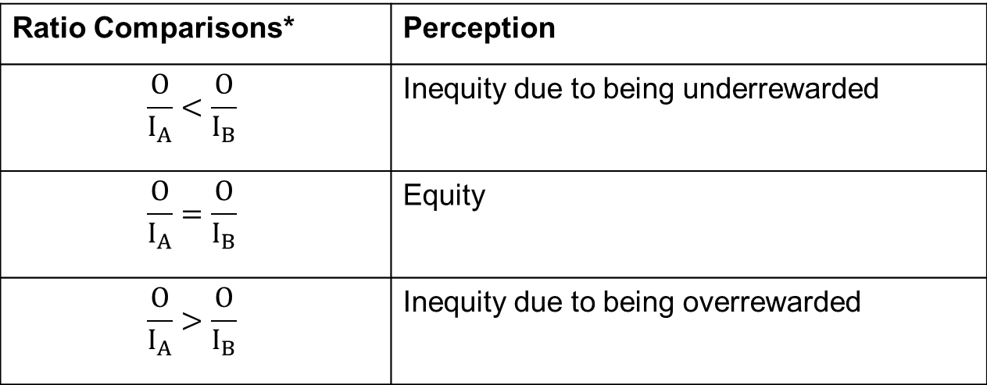
Forms of Organizational Justice (1 of 5)
Exhibit 7-7 Equity Theory
Ratio Comparisons* | Perception
$$\frac{O}{I_{A}}<\frac{O}{I_{B}}$$ | Inequity due to being underrewarded
$$\frac{O}{I_{A}}=\frac{O}{I_{B}}$$ | Equity
$$\frac{O}{I_{A}}>\frac{O}{I_{B}}$$ | Inequity due to being overrewarded
*Where $\frac{O}{I_{A}}$ represents the employee and $\frac{O}{I_{B}}$ represents relevant others
Notes:
What role does equity play in motivation? Equity theory argues that individuals make comparisons of their job inputs and outcomes relative to those of others and then respond to any inequities. If we perceive our ratio to be equal to that of the relevant others with whom we compare ourselves, a state of equity is said to exist. We perceive our situation as fair. When we see the ratio as unequal, we experience equity tension.

Slide 31
Forms of Organizational Justice (2 of 5)
When employees perceive an inequity, they can be predicted to make one of six choices:
  Change inputs.
  Change outcomes.
  Distort perceptions of self.
  Distort perceptions of others.
  Choose a different referent.
  Leave the field.
Notes:
When employees perceive an inequity, they can be predicted to make one of six choices: they can change inputs, change outcomes, distort perceptions of self, distort perceptions of others, choose a different referent, or they can leave the field.

Slide 32
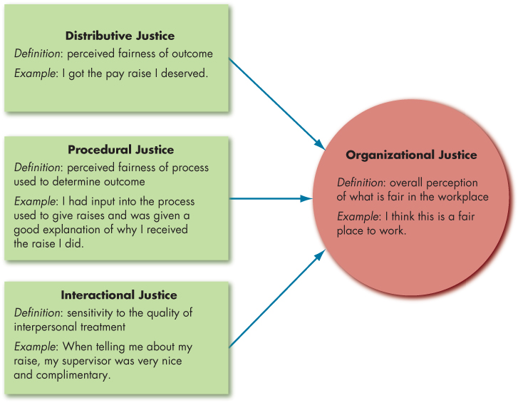
Forms of Organizational Justice (3 of 5)
Exhibit 7-8 Model of Organizational Justice
Notes:
Although equity theory’s propositions have not all held up, the hypothesis served as an important precursor to the study of organizational justice, or more simply, fairness, in the workplace. Organizational justice is concerned with how employees feel they are treated by authorities and decision makers at work. For the most part, employees make their evaluations along four dimensions, as shown in Exhibit 7-8.
Distributive justice is concerned with the fairness of the outcomes, such as pay and recognition that employees receive. Although employees care a lot about what outcomes are distributed (distributive justice), they also care a lot about how outcomes are distributed. While distributive justice looks at what outcomes are allocated, procedural justice examines how outcomes are allocated. Having direct influence over how decisions or made, or at the very least being able to present your opinion to decision makers, creates a sense of control and makes us feel empowered. Employees also perceive that procedures are fairer when decision makers follow several “rules.” It turns out that procedural and distributive justice combine to influence people’s perceptions of fairness. If outcomes are favorable and individuals get what they want, they care less about the process, so procedural justice doesn’t matter as much when distributions are perceived to be fair.
Research has shown that employees care about two other types of fairness that have to do with the way they are treated during interactions with others.
The first type is informational justice, which reflects whether managers provide employees with explanations for key decisions and keep them informed of important organizational matters. The second type of justice relevant to interactions between managers and employees is interpersonal justice, which reflects whether employees are treated with dignity and respect.

Slide 33
Forms of Organizational Justice (4 of 5)
Justice Outcomes
  All the types of justice discussed have been linked to higher levels of task performance and citizenship.
  Third-party, or observer, reactions to injustice can be substantial.
Notes:
After all this talk about types of justice, how much does justice really matter to employees? A great deal, as it turns out. When employees feel fairly treated, they respond in many positive ways. All the types of justice discussed in this section have been linked to higher levels of task performance and citizenship behaviors such as helping coworkers, as well as lower levels of counterproductive behaviors such as shirking job duties.
Why does justice have these positive effects? Fair treatment enhances commitment to the organization and makes employees feel it cares about their well-being. In addition, employees who feel fairly treated trust their supervisors more, which reduces uncertainty and fear of being exploited by the organization. Finally, fair treatment elicits positive emotions, which in turn prompts behaviors like citizenship.
Your coworker’ reactions to injustice can be just as important as your own. Research is beginning to suggest that third party, or observer, reactions to injustice can have a substantial effect.

Slide 34
Forms of Organizational Justice (5 of 5)
Promoting Justice
  Adopting strong justice guidelines in an attempt to mandate certain managerial behavior isn’t likely to be universally effective.
Culture and Justice
  Inputs and outcomes are valued differently in various cultures.
Notes:
How can an organization affect the justice perceptions and rule adherence of its managers? This depends upon the motivation of each manager. Some managers are likely to calculate justice by their degree of adherence to the justice rules of the organization. These managers will try to gain greater subordinate compliance with behavioral expectations, create an identity of being fair to their employees, or establish norms of fairness. Other managers may be motivated in justice decisions by their emotions. When they have a high positive affect and/or a low negative affect, these managers are most likely to act fairly.
It might be tempting for organizations to adopt strong justice guidelines in attempts to mandate managerial behavior, but this isn’t likely to be universally effective. In cases where managers have more rules and less discretion, those who calculate justice are more likely to act fairly, but managers whose justice behavior follows from their affect may act more fairly when they have greater discretion.
Across nations, the same basic principles of procedural justice are respected in that workers around the world prefer rewards based on performance and skills over rewards based on seniority. However, inputs and outcomes are valued differently in various cultures.

Slide 35
Implications of Job Engagement for Management (1 of 3)
Job engagement: the investment of an employee’s physical, cognitive, and emotional energies into job performance.
  Gallup organization: more engaged employees in successful organizations than in average organizations.
  Academic studies: job engagement is positively associated with performance and citizenship behaviors.
Notes:
Job engagement is the investment of an employee’s physical, cognitive, and emotional energies into job performance. Practicing managers and scholars alike have lately become interested in facilitating job engagement, believing something deeper than liking a job or finding it interesting drives performance. Many studies attempt to measure this deeper level of commitment.

Slide 36
Implications of Job Engagement for Management (2 of 3)
What makes people more engaged in their job?
  The degree to which an employee believes it is meaningful to engage in work.
  A match between the individual’s values and the organization’s.
  Leadership behaviors that inspire workers to a greater sense of mission.
Notes:
What makes people more likely to be engaged in their jobs? One key is the degree to which an employee believes it is meaningful to engage in work. This is partially determined by job characteristics and access to sufficient resources to work effectively. Another factor is a match between the individual’s values and those of the organization. In addition, leadership behaviors that inspire workers to a greater sense of mission also increase employee engagement.

Slide 37
Implications of Job Engagement for Management (3 of 3)
Are highly engaged employees getting “too much of a good thing?”
  Construct is partially redundant with job attitudes.
  It may have a “dark side.”
    Positive relationships between engagement and work-family conflict.
Notes:
One of the critiques of engagement is that the construct is partially redundant with job attitudes such as satisfaction or stress. However, engagement questionnaires usually assess motivation and absorption in a task, quite unlike job satisfaction questionnaires. Engagement may also predict important work outcomes better than traditional job attitudes. Others critics note there may be a “dark side” to engagement, as evidenced by positive relationships between engagement and work–family conflict.
Individuals might grow so engaged in their work roles that family responsibilities become an unwelcomed intrusion. Further research exploring how engagement relates to these negative outcomes may help clarify whether some highly engaged employees might be getting “too much of a good thing.”

Slide 38
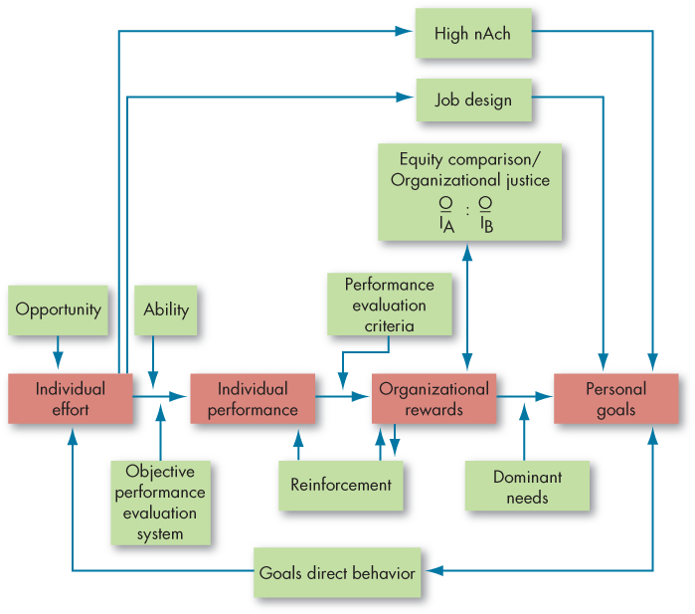
Compare Contemporary Theories of Motivation
Exhibit 7-9 Integrating Contemporary Theories of Motivation
Notes:
Exhibit 7-9 integrates much of what we know about motivation. Its basic foundation is the expectancy model. Expectancy theory predicts that an employee will exert a high level of effort if he or she perceives that there is a strong relationship between effort and performance, performance and rewards, and rewards and satisfaction of personal goals. Each of these relationships, in turn, is influenced by certain factors. For effort to lead to good performance, the individual must have the requisite ability to perform, and the performance appraisal system must be perceived as being fair and objective. The final link in expectancy theory is the rewards–goals relationship.
The model also considers the achievement, need, reinforcement, and equity/organizational justice theories. High achievers are internally driven as long as the jobs they are doing provide them with personal responsibility, feedback, and moderate risks. Reinforcement theory recognizes that the organization’s rewards reinforce the individual’s performance. Individuals will compare the rewards they receive (outcomes) from the inputs they make with the outcome–input ratio of relevant others, and inequities may influence the effort expended.

Slide 39
Implications for Managers (1 of 2)
Make sure extrinsic rewards for employees are not viewed as coercive, but instead provide information about competence and relatedness.
Either set or inspire your employees to set specific, difficult goals and provide quality, developmental feedback on their progress toward those goals.
Try to align or tie in employee goals to the goals of your organization.
Model the types of behaviors you would like to see performed by your employees.
Notes:
Motivation describes the processes (e.g., intensity, direction, and persistence) underlying how employees and other individuals in the workplace direct their efforts toward a goal. Although not well supported, many foundational early theories of motivation focused on the needs that employees have along with the consequences of need satisfaction. More contemporary theories focused on such topics as intrinsic and extrinsic motivation, setting goals in organizations, self-efficacy, reinforcement, along with our expectations regarding effort, performance, reward, and outcome relationships. Beyond these theories, various forms of organizational justice (e.g., distributive, procedural, and interactional), all deriving from equity theory, are important in motivating employees. Motivation is key to understanding employees’ contributions to their work, including their job engagement. Overall, motivation underlies how and why employees exert effort to engage in performance activities, which in turn meet personal or organizational goals.
Implications for managers:
• Make sure extrinsic rewards for employees are not viewed as coercive, but instead provide information about competence and relatedness.
• Either set or inspire your employees to set specific, difficult goals and provide quality, developmental feedback on their progress toward those goals.
• Try to align or tie in employee goals to the goals of your organization.

Slide 40
Implications for Managers (2 of 2)
Expectancy theory offers a powerful explanation of performance variables such as employee productivity, absenteeism, and turnover.
When making decisions regarding resources in your organization, make sure to consider how the resources are being distributed (and who’s impacted), the fairness of the decision, along with whether your actions demonstrate that you respect those involved.
Notes:
In addition:
Expectancy theory offers a powerful explanation of performance variables such as employee productivity, absenteeism, and turnover.
When making decisions regarding resources in your organization, make sure to consider how the resources are being distributed (and who’s impacted), the fairness of the decision, along with whether your actions demonstrate that you respect those involved.

Slide 41
Learning Objectives (1 of 2)
7.1 Describe the three key elements of motivation.
7.2 Compare the early theories of motivation.
7.3 Contrast the elements of self-determination theory and goal-setting theory.
7.4 Understand the differences among self-efficacy theory, reinforcement theory, and expectancy theory.
Notes:
After studying this chapter, you should be able to:
Describe the three key elements of motivation.
Compare the early theories of motivation.
Contrast the elements of self-determination theory and goal-setting theory.
Understand the differences among self-efficacy theory, reinforcement theory, and expectancy theory.

Slide 42
Learning Objectives (2 of 2)
7.5 Describe the forms of organizational justice, including distributive justice, procedural justice, informational justice, and interactional justice.
7.6 Identify the implications of employee job engagement for managers.
7.7 Describe how the contemporary theories of motivation complement one another.
Notes:
In addition, after studying this chapter, you should be able to:
Describe the forms of organizational justice, including distributive justice, procedural justice, informational justice, and interactional justice.
Identify the implications of employee job engagement for managers.
Describe how the contemporary theories of motivation complement one another.

Slide 43
Questions?

